Slide 1
Arrays, Records and Pointers
Instructors:
Md Nazrul Islam Mondal
Department of Computer Science & Engineering
Rajshahi University of Engineering & Technology Rajshahi-6204

Slide 2
Outline
Multidimensional Array
Pointers: Pointer Array
Records: Record Structure
Representation of Records in Memory: Parallel Arrays
Matrices
Sparse Matrices

Slide 3
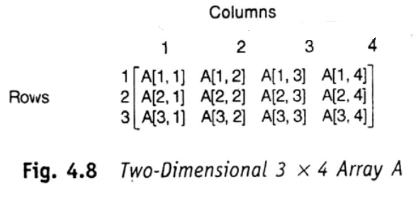
Multidimensional Array
Two dimensional Array:
A_{J,K} or A[J,K]

Slide 4
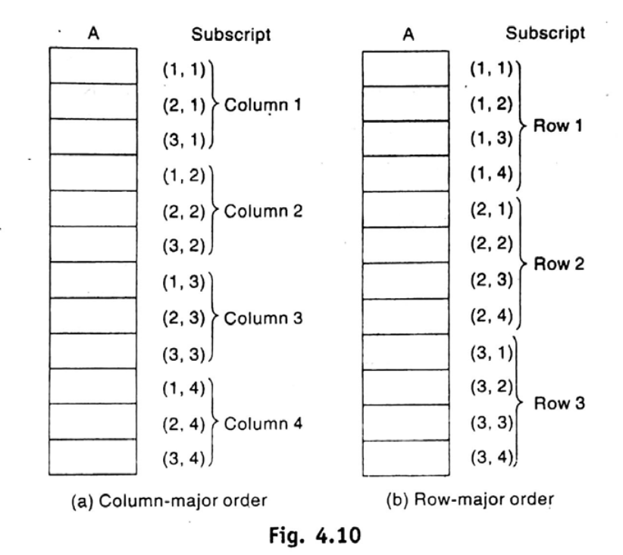
Multidimensional Array
Representation of Two dimensional Array in memory:

Slide 5
Multidimensional Array
General Multidimensional Arrays:
B_{K1 ,k2,k3,….,kn} or B[K₁,K₂, . . . , K_{N}

Slide 6
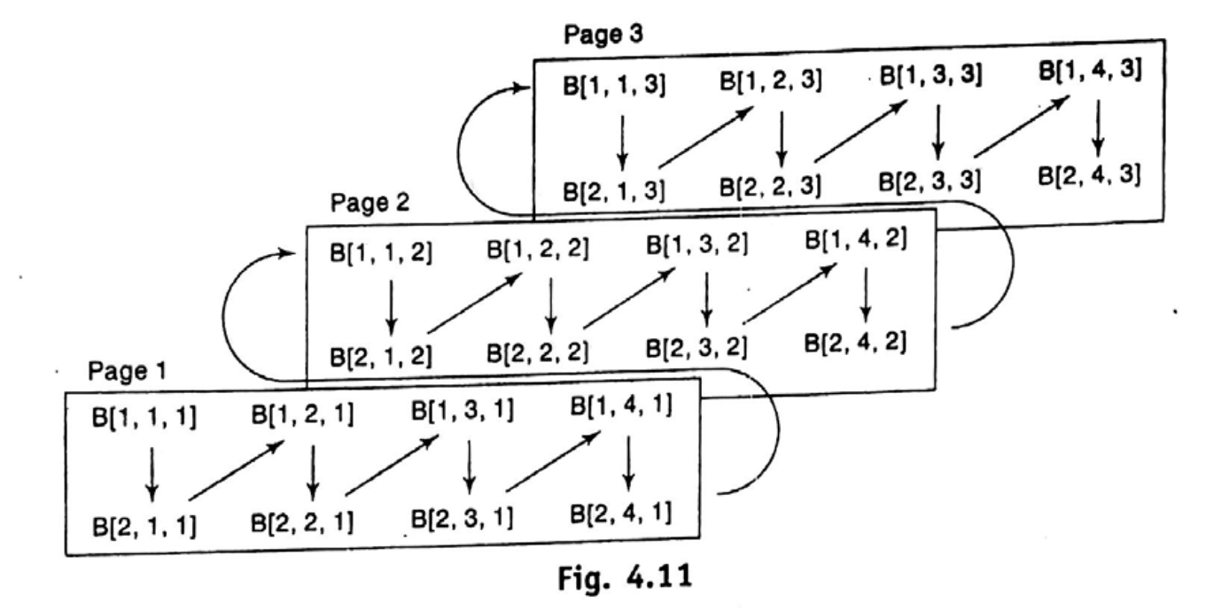
Multidimensional Array

Slide 7
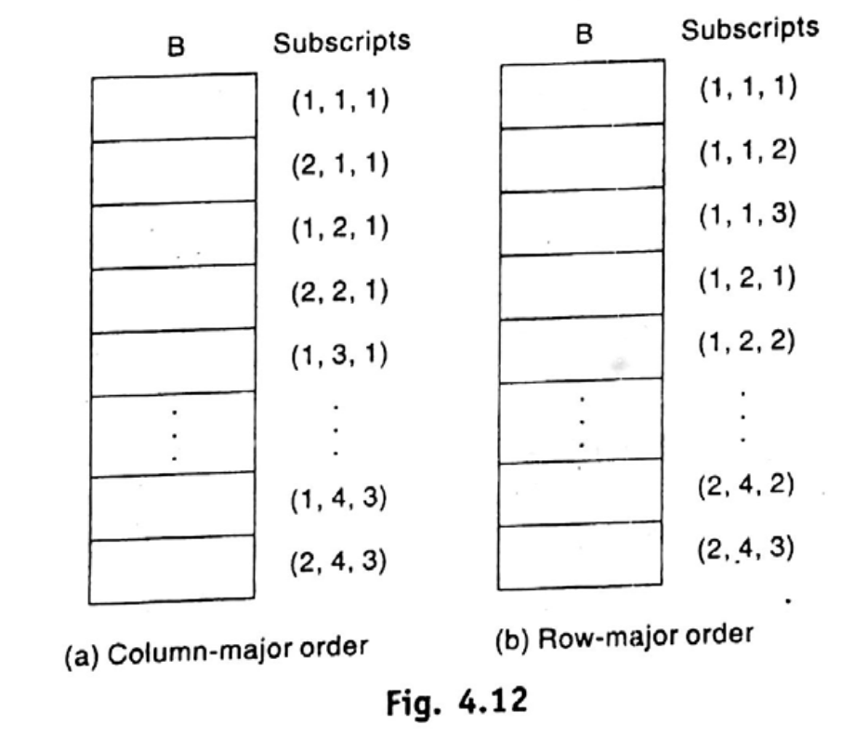
Multidimensional Array

Slide 8
Pointers: Pointer Array

Slide 9
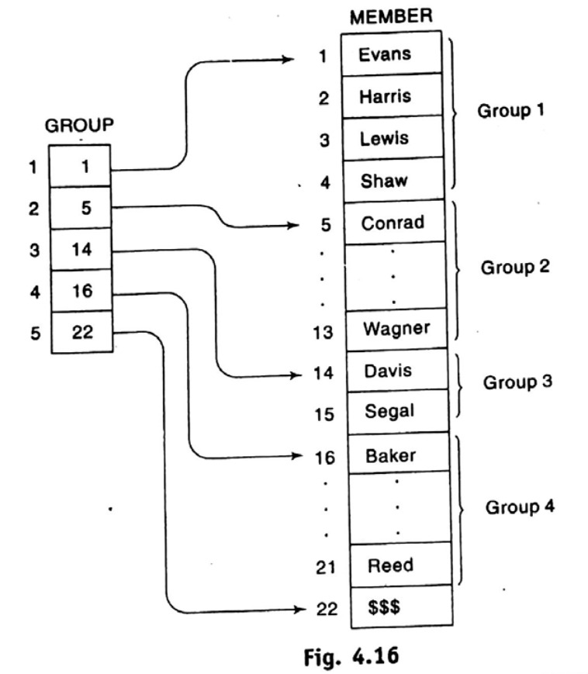
Pointers: Pointer Array
Pointer Array

Slide 10
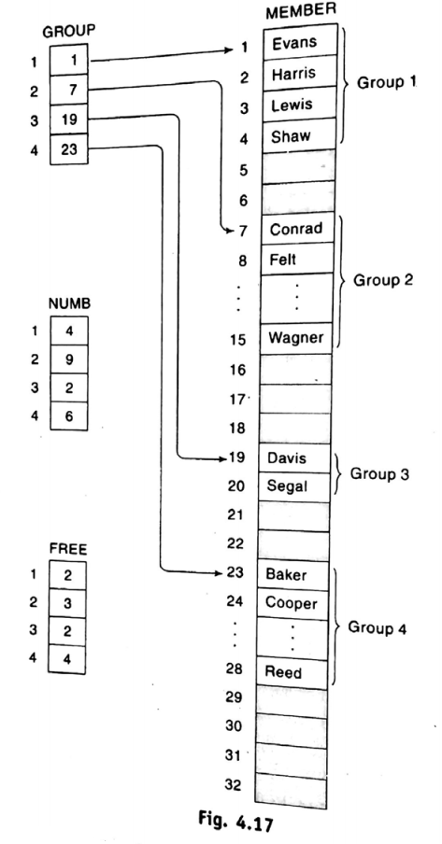
Pointers: Pointer Array
Pointer Array

Slide 11
Records: Record Structure

Slide 12
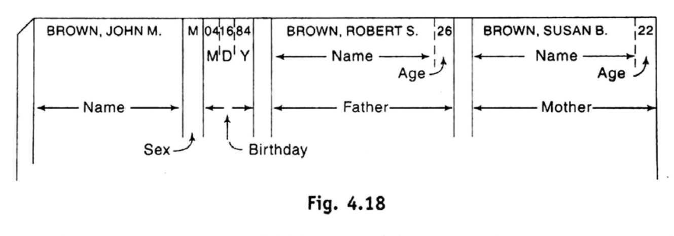
Records: Record Structure
Differs from a linear array in the following ways –
A record may be a collection of nonhomogeneous data
The data items in a record are indexed by attribute name, so there may not be a natural ordering of its element.

Slide 13
Representation of Records in Memory: Parallel Arrays

Slide 14
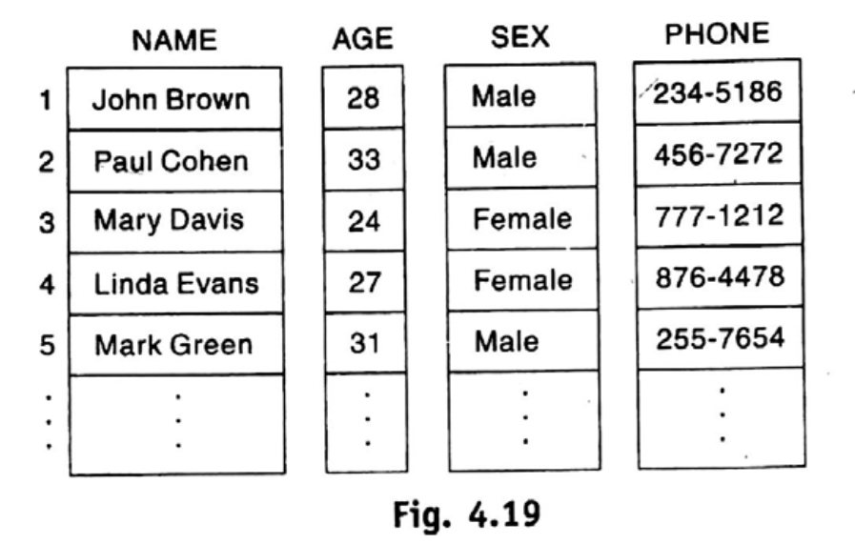
Representation of Records in Memory: Parallel Arrays

Slide 15
Matrices

Slide 16
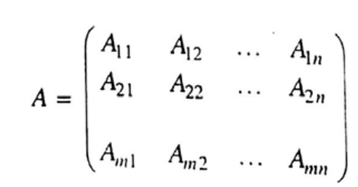
Matrices
An n-elements vector V –
V = (V₁, V₂, . . . , V_{n})
An mxn matrix A -

Slide 17
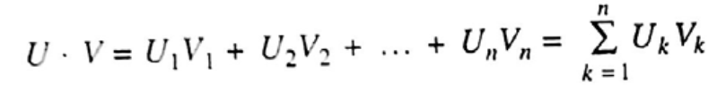
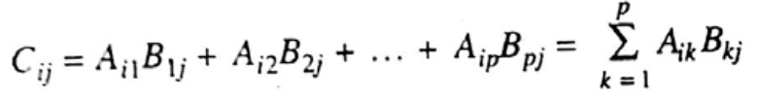


Matrices
Scalar Product of two n-elements vectors V and U –
Matrix multiplication

Slide 18
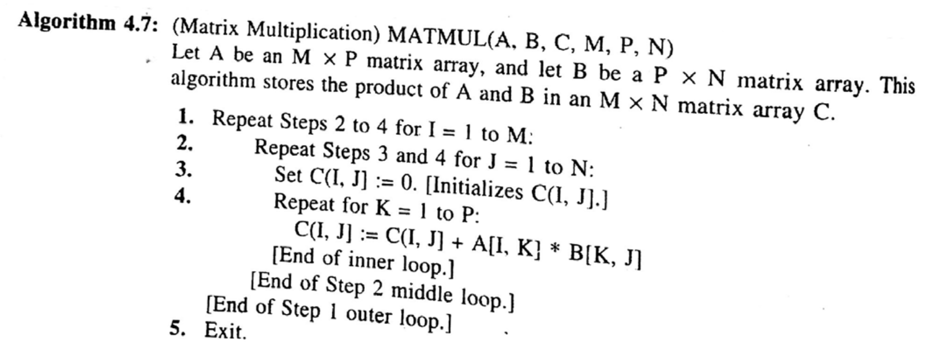
Matrices
Complexity: O(n³)

Slide 19
Sparse Matrices

Slide 20
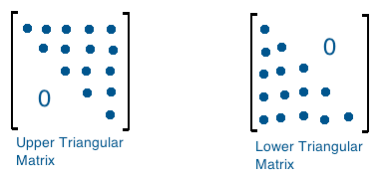
Sparse Matrices
High proportion of zero entries.

Slide 21
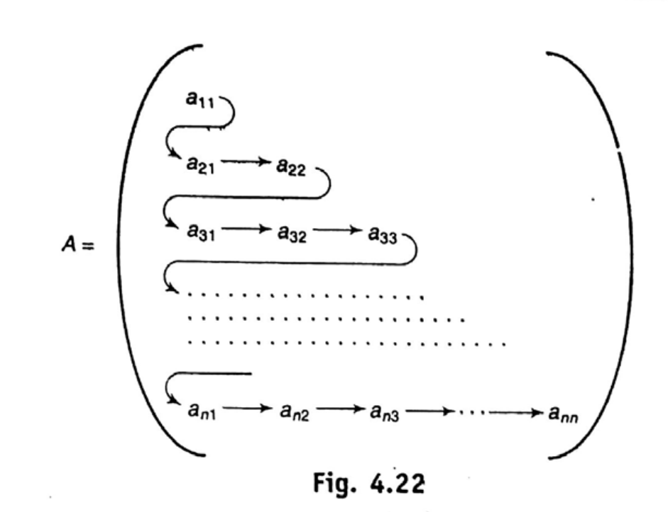
Sparse Matrices

Slide 22
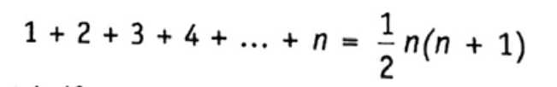
Sparse Matrices

Slide 23

Sparse Matrices
1st row – 1 element
2nd row – 2 elements
….
Jth row – k elements
(J-1)th row –
1+2 + …. + (J-1)
So L = 1+2+… +(J-1) + K

Slide 24
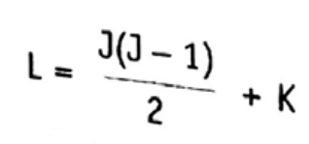
Sparse Matrices

Slide 25
END

